Slide 1


Cloud Computing and Security
BIS613D
Module 5
Features of Cloud and Grid Platforms
Department of ISE

Slide 2
Cloud Capabilities and Platform Features
Commercial clouds need broad set of capabilities.
These capabilities offer cost-effective utility computing with the elasticity to scale up and down in power
Commercial clouds provides growing number of additional capabilities
Examples
  Microsoft Azure – Azure Table, queues, blobs, Database SQL, and web and Worker roles
  Amazon – SimpleDB (similar to Azure Table), queues, notification, monitoring, content delivery network, relational database, and MapReduce (Hadoop)
  Google – Google AppEngine

Slide 3
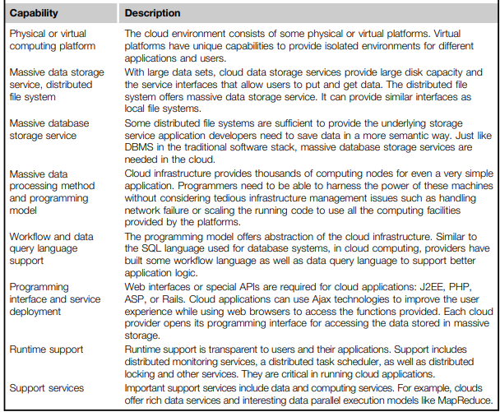

Slide 4
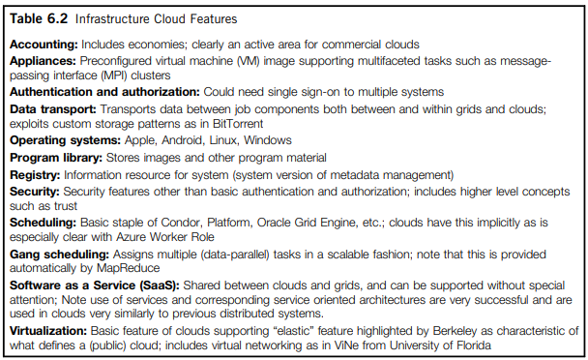

Slide 5
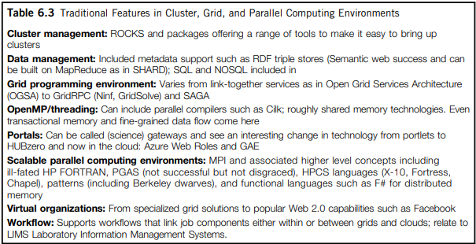

Slide 6
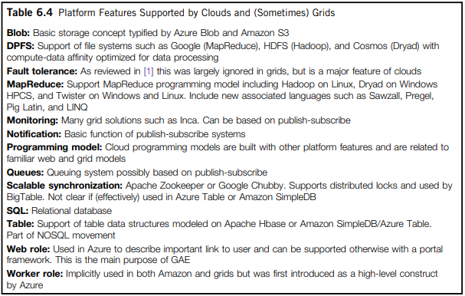

Slide 7
Traditional Features Common to Grids & Clouds
Workflow
  Workflow has spawned many projects in the United States and Europe
  Pegasus, Taverna, and Kepler are popular, but no choice has gained wide acceptance
  Trident from Microsoft Research which is built on top of Windows Workflow Foundation
  Workflow links multiple cloud and non-cloud services in real applications on demand
Data Transport
  Cost (in time and money) of data transport in (and to a lesser extent, out of) commercial clouds is often discussed as a difficulty in using clouds
  If commercial clouds become an important component of the national cyberinfrastructure we can expect that high-bandwidth links will be made available between clouds and TeraGrid
  The special structure of cloud data with blocks (in Azure blobs) and tables could allow high-performance parallel algorithms

Slide 8
Traditional Features Common to Grids & Clouds
Security, Privacy, and Availability
  Use virtual clustering to achieve dynamic resource provisioning with minimum overhead cost.
  Use stable and persistent data storage with fast queries for information retrieval.
  Use special APIs for authenticating users and sending e-mail using commercial accounts.
  Cloud resources are accessed with security protocols such as HTTPS and SSL.
  Fine-grained access control is desired to protect data integrity and deter intruders or hackers.
  Shared data sets are protected from malicious alteration, deletion, or copyright violations.
  Features are included for availability enhancement and disaster recovery with life migration
  of VMs.
  Use a reputation system to protect data centers. This system only authorizes trusted clients and stops pirates.

Slide 9
Data Features and Databases
Program library – Designing a VM image library to manage images used in academic and commercial clouds
Blobs and Drives – Basic storage concept in clouds is blobs for Azure and S3 for Amazon
DPFS (DPU-Powered File System) – File systems such as Google File System (MapReduce), HDFS (Hadoop), and Cosmos (Dryad) with compute-data affinity optimized for data processing
SQL and Relational Databases – Implements “SQL as a Service”
Table and NoSQL Non-relational Databases - 3 major clouds: BigTable in Google, SimpleDB in Amazon, and Azure Table for Azure
  Azure Table and Amazon SimpleDB are quite similar and support lightweight storage for “document stores”
  BigTable aims to manage large distributed data sets without size limitations
Queuing Services – Robust queuing services that are used to communicate between the components of an application

Slide 10
Programming and Run Time Support
Worker and Web Roles –
  Worker roles are basic schedulable processes and are automatically launched, like the “gang scheduling” supported transparently in MapReduce.
  Web roles provide an interesting approach to the web portals of applications.
MapReduce –
  A substantial interest in “data parallel” languages largely aimed at loosely coupled computations which execute over different data samples.
  major open source/commercial
  MapReduce implementations are Hadoop and Dryad with execution possible with or without VMs
Cloud Programming Models –
  Iterative MapReduce is an interesting programming model that offers portability between cloud, HPC and cluster environments.
SaaS –
  “Systems software as a service” was an interesting idea in the context of a database service.
  Need protection features that may help us to achieve scalability, security, privacy, and availability

Slide 11
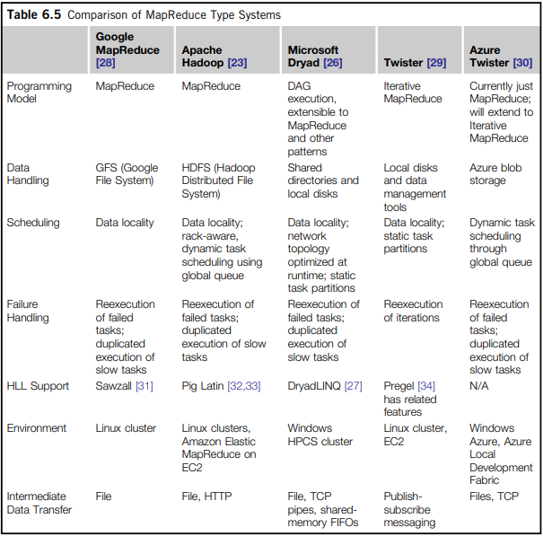

Slide 12
Recollect Quiz
______________ need broad set of capabilities.
In infrastructure cloud features ___________________ is an active area for commercial clouds.
_________________ can include parallel compilers such as Cilk.
_________________ links multiple cloud and non-cloud services in real applications on demand.
_________________ is desired to protect data integrity and deter intruders or hackers.
_________________ is an interesting programming model that offers portability between cloud, HPC and cluster environments
Notes:
Commercial Clouds
Accounting
OpenMP/threading
Workflow
Fine-grained access control
Iterative MapReduce

Slide 13
Possible Questions in the IAT/Exam
List and explain the traditional features common to Clouds and Grids.
List and explain the Data and Database features common to Clouds and Grids
Compare the MapReduce type Systems in Cloud.
What are the features of programming and runtime support needed in a Cloud?
What are the traditional features in Grid, Cloud and Parallel computing environments?

Slide 14
THANK YOU

